Slide 1
What Christmas is really about
John chapter 3: 1-17

Slide 2
Christmas is an annual festival commemorating the birth of Jesus Christ, observed primarily on December 25^{[a]} as a religious and cultural celebration among billions of people around the world.

Slide 3
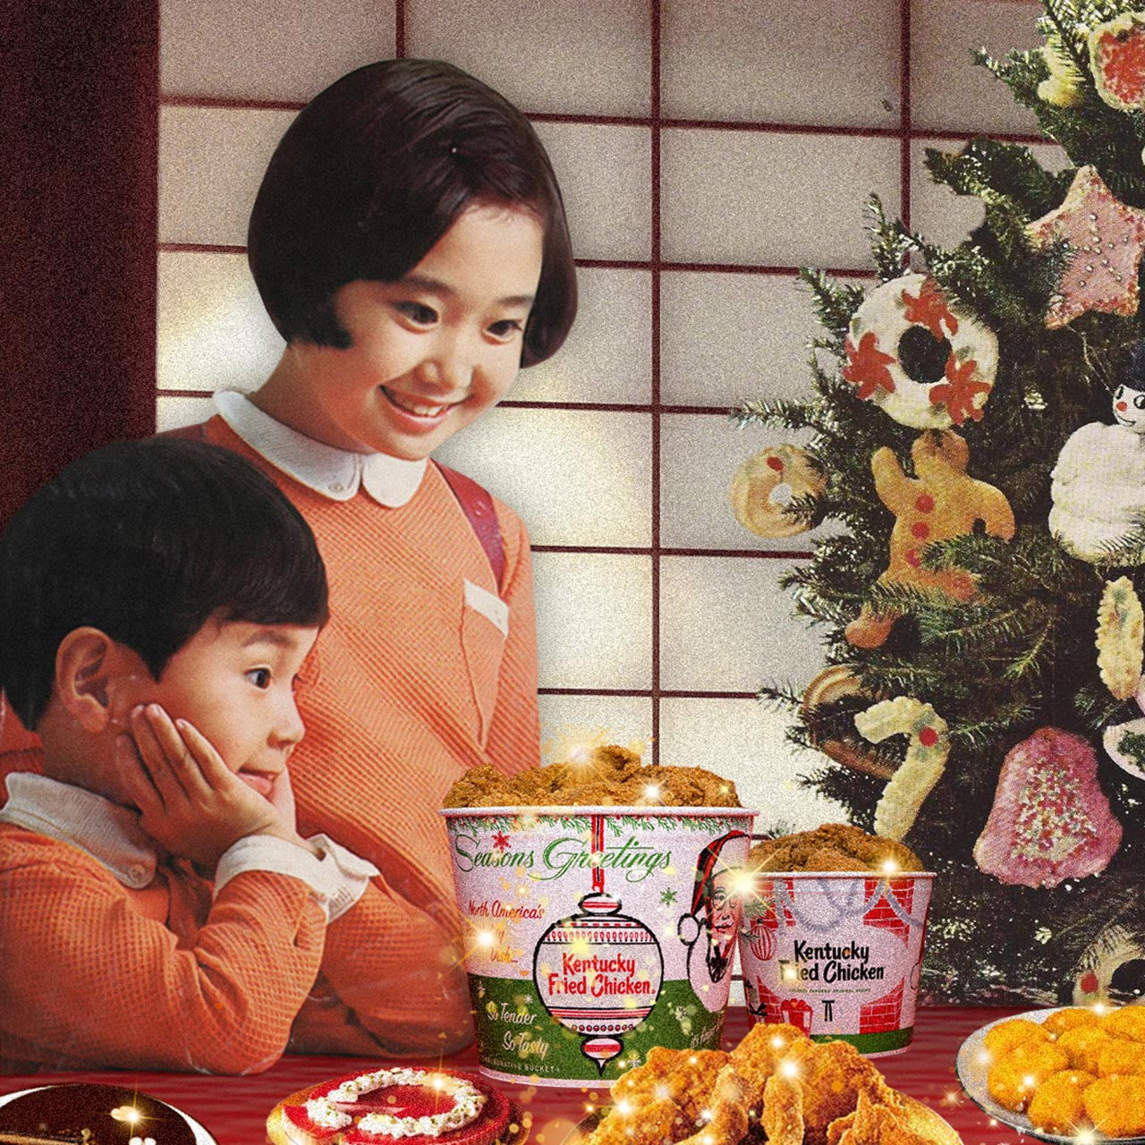

Slide 5
John 3: 1-17 Jesus’ encounter with Nicodemus
There was a man of the Pharisees named Nicodemus, a ruler of the Jews. This man came to Jesus by night and said to Him, “Rabbi, we know that You are a teacher come from God; for no one can do these signs that You do unless God is with him.” Jesus answered and said to him, “Most assuredly, I say to you, unless one is born again, he cannot see the kingdom of God.” (John 3:1-3).
To enter God’s Kingdom you must be born again

Slide 6
“Most assuredly, I say to you, unless one is born of water and the Spirit, he cannot enter the kingdom of God. That which is born of the flesh is flesh, and that which is born of the Spirit is spirit. Do not marvel that I said to you, ‘You must be born again.’ The wind blows where it wishes, and you hear the sound of it, but cannot tell where it comes from and where it goes. So is everyone who is born of the Spirit” (vv. 5-8).
Not physical rebirth but spiritual rebirth

Slide 7
Jesus answered and said to him, “Are you the teacher of Israel, and do not know these things? Most assuredly, I say to you, We speak what We know and testify what We have seen, and you do not receive Our witness. If I have told you earthly things and you do not believe, how will you believe if I tell you heavenly things? No one has ascended to heaven but He who came down from heaven, that is, the Son of Man who is in heaven” (v. 10-13).
But how can this be? Through Jesus who came down from heaven, to tell us these things and to make them possible.

Slide 8
Jesus was telling Nicodemus that that Old Testament story of Moses saving his people was a picture of Himself.
“And as Moses lifted up the serpent in the wilderness, even so must the Son of Man be lifted up, that whoever believes in Him should not perish but have eternal life” (vv. 14-15).

Slide 9
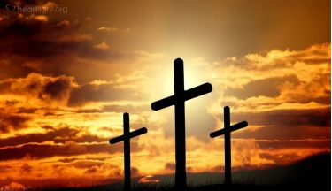
For God so loved the world that He gave His only begotten Son, that whoever believes in Him should not perish but have everlasting life. For God did not send His Son into the world to condemn the world, but that the world through Him might be saved (vv. 16-17, NIV).
“This is how much God loved the world: He gave his Son, his one and only Son. And this is why: so that no one need be destroyed; by believing in him, anyone can have a whole and lasting life. God didn’t go to all the trouble of sending his Son merely to point an accusing finger, telling the world how bad it was. He came to help, to put the world right again. Anyone who trusts in him is acquitted; anyone who refuses to trust him has long since been under the death sentence without knowing it. (vv. 16-17, Message).

Slide 10
Christmas is about God’s
Love
Sacrificial Gift
Open invitation
Mercy for all

Slide 11
1. God’s love
And He Himself is the propitiation [a gift that averts the extreme anger of God] for our sins, and not for ours only but also for the whole world (1 John 2:2).

Slide 12
1. God’s love
When we read that God the Father “so loved” that He gave His only Son, we know that He did so out of love for the whole world. It wasn’t that Jesus came into this world to persuade His Father to love us; but rather that the Father already loved the world so much that He sent His Son to save us.

Slide 13
2. God’s sacrificial gift
What then shall we say to these things? If God is for us, who can be against us? He who did not spare His own Son, but delivered Him up for us all, how shall He not with Him also freely give us all things? (Romans 8:31-32).

Slide 14
2. God’s sacrificial gift
The Father’s giving was unlimited and unreserved. He gave that which is most precious to Him—His own Son.

Slide 15
3. God’s open invitation
All that the Father gives Me will come to Me, and the one who comes to Me I will by no means cast out (John 6:37).

Slide 16
3. God’s open invitation
Christmas happened because God welcomes anyone who wants to be saved. No matter who they are; no matter what they have done; no matter how much of a sinner they have been—“whoever believes on Him” is welcomed to come.

Slide 17
4. God’s mercy for all
For the wages of sin is death, but the gift of God is eternal life in Christ Jesus our Lord (Romans 6:23).

Slide 18
4. God’s saving mercy
The free gift of God through Jesus Christ is not just about saving us from eternal punishment. God doesn’t just save us and then tell us to go on our way. The free gift of God through Jesus is ‘eternal life’. And eternal life is much more than simply about ‘duration’. It’s about ‘relationship’

